Slide 1

Session 2 Data Analytics Lifecycle

Slide 2
Lifecycle Overview
The data analytic lifecycle is designed for Big Data problems and data science projects
With six phases the project work can occur in several phases simultaneously
The cycle is iterative
Work can return to earlier phases as new information is uncovered

Slide 3
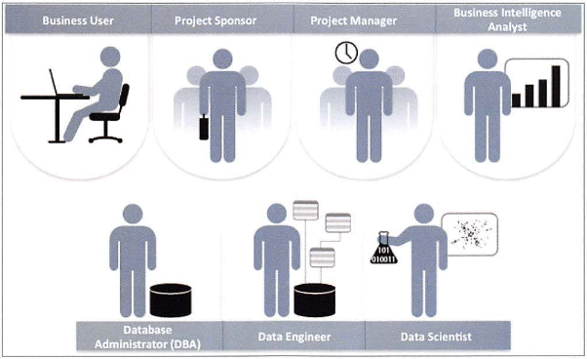
Key Roles in Analytics Project

Slide 4
Description of Key Roles in Analytics Project
Business User – understands the domain area
Project Sponsor – provides requirements
Project Manager – ensures meeting objectives
Business Intelligence Analyst – provides business domain expertise based on deep understanding of the data
Database Administrator (DBA) – creates DB environment
Data Engineer – provides technical skills, assists data management and extraction, supports analytic sandbox
Data Scientist – provides analytic techniques and modeling

Slide 5
Motivational Models for Data Analytics Lifecycle
Data Analytics Lifecycle have adopted certain best practices from existing models detailed below:
The Lifecycle employs aspects of following models:
Scientific method
Cross Industry Standard Process for Data Mining (CRISP-DM)
Process model for data mining
Davenport’s DELTA framework
Hubbard’s Applied Information Economics (AIE) approach
MAD Skills: New Analysis Practices for Big Data by Cohen et al.

Slide 6

Cross Industry Standard Process for Data Mining (CRISP-DM)

Slide 7
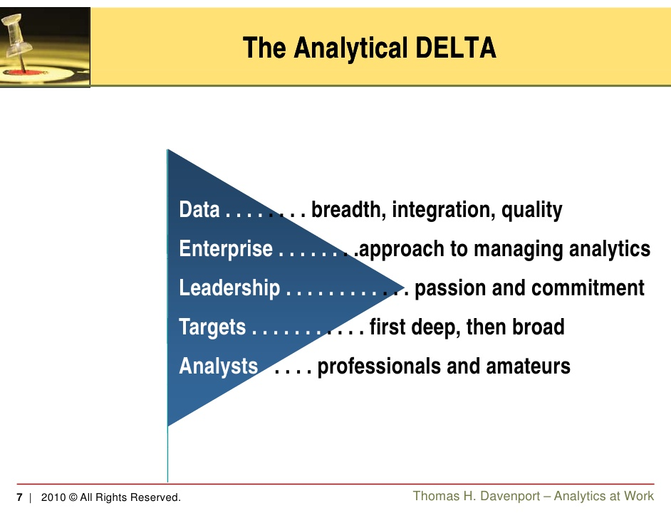
Davenport’s DELTA framework

Slide 8
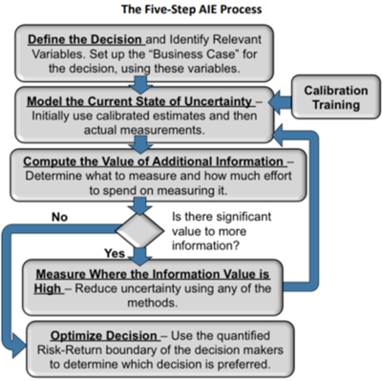
Hubbard’s Applied Information Economics (AIE) approach

Slide 9
MAD is Magnetic, Agile, Deep data analysis
The authors define the MAD acronym as a re-imagination of the data warehouse concept such that:
Magnetic: encourages (attracts) new data sources, has reduced sensitivity to cleanliness of data sources
Agile: logical and physical contents of the database can evolve and adapt rapidly
Deep: Avoid BI rollups and sampling to serve more demanding statistical analyses.
Presented as an alternative to “traditional Enterprise Data Warehouses and Business Intelligence.”
Emphasis is on moving data to a data warehouse rapidly, and using a staged approach to clean and integrate the new data.

Slide 10
Data Analytics Lifecycle Phases
Extracting best practices from these models, Data Analytics Life cycle phases were framed as follows:
Phase 1: Discovery
Phase 2: Data Preparation
Phase 3: Model Planning
Phase 4: Model Building
Phase 5: Communicate Results
Phase 6: Operationalize

Slide 11
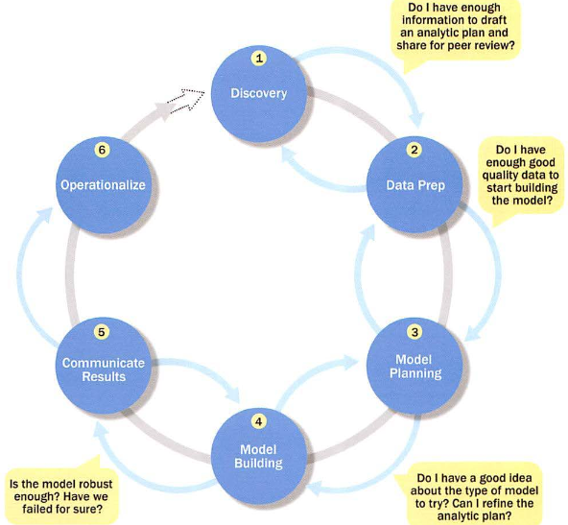
Key activity in each phase of Data Analytics Lifecycle

Slide 12
Phase 1: Discovery- Activities
Learning the Business Domain
Acquiring Resources
Framing the Problem Definition
Identifying Key Stakeholders
Interviewing the Analytics Sponsor
Developing Initial Hypotheses
Identifying Potential Data Sources

Slide 13
Phase 2: Data Preparation
It has the following activities
Preparing the Analytic Sandbox
Performing ETLT
Learning about the Data
Data Conditioning
Survey and Visualize
Common Tools for Data Preparation

Slide 14
2.1 Preparing the Analytic Sandbox
Create the analytic sandbox (also called workspace)
Allows team to explore data without interfering with live production data
Sandbox collects all kinds of data (expansive approach)
The sandbox allows organizations to undertake ambitious projects beyond traditional data analysis and BI to perform advanced predictive analytics
Although the concept of an analytics sandbox is relatively new, this concept has become acceptable to data science teams and IT groups

Slide 15
2.2 Performing ETLT (Extract, Transform, Load, Transform)
In ETL users perform extract, transform, load
In the sandbox the process is often ELT – early load preserves the raw data which can be useful to examine
Example – in credit card fraud detection, outliers can represent high-risk transactions that might be inadvertently filtered out or transformed before being loaded into the database
Hadoop is often used here

Slide 16
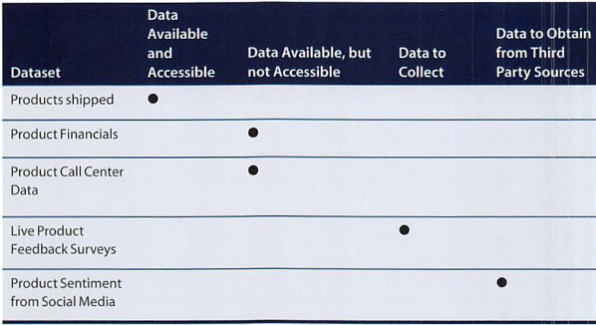
2.3 Learning about the Data
Becoming familiar with the data is critical
This activity accomplishes several goals:
Determines the data available to the team early in the project
Highlights gaps – identifies data not currently available
Identifies data outside the organization that might be useful

Slide 17
2.4 Data Conditioning
Data conditioning includes cleaning data, normalizing datasets, and performing transformations
Often viewed as a preprocessing step prior to data analysis, it might be performed by data owner, IT department, DBA, etc.
Best to have data scientists involved
Data science teams prefer more data than too little
Additional questions and considerations
What are the data sources? Target fields?
How clean is the data?
How consistent are the contents and files? Missing or inconsistent values?
Assess the consistence of the data types – numeric, alphanumeric?
Review the contents to ensure the data makes sense
Look for evidence of systematic error

Slide 18
2.5 Survey and Visualize
Leverage data visualization tools to gain an overview of the data
Shneiderman’s mantra:
“Overview first, zoom and filter, then details-on-demand”
This enables the user to find areas of interest, zoom and filter to find more detailed information about a particular area, then find the detailed data in that area
Guidelines and Considerations
Review data to ensure calculations are consistent
Does the data distribution stay consistent?
Assess the granularity of the data, the range of values, and the level of aggregation of the data
Does the data represent the population of interest?
Check time-related variables – daily, weekly, monthly? Is this good enough?
Is the data standardized/normalized? Scales consistent?
For geospatial datasets, are state/country abbreviations consistent

Slide 19
2.6. Common Tools for Data Preparation
Hadoop can perform parallel ingest and analysis
Alpine Miner provides a graphical user interface for creating analytic workflows
OpenRefine (formerly Google Refine) is a free, open source tool for working with messy data
Similar to OpenRefine, Data Wrangler is an interactive tool for data cleansing an transformation

Slide 20
Phase 3: Model Planning
Activities to consider
Assess the structure of the data – this dictates the tools and analytic techniques for the next phase
Ensure the analytic techniques enable the team to meet the business objectives and accept or reject the working hypotheses
Determine if the situation warrants a single model or a series of techniques as part of a larger analytic workflow
Research and understand how other analysts have approached this kind or similar kind of problem

Slide 21
Phase 3: Model Planning
Activities to consider
Assess the structure of the data – this dictates the tools and analytic techniques for the next phase
Ensure the analytic techniques enable the team to meet the business objectives and accept or reject the working hypotheses
Determine if the situation warrants a single model or a series of techniques as part of a larger analytic workflow
Research and understand how other analysts have approached this kind or similar kind of problem

Slide 22
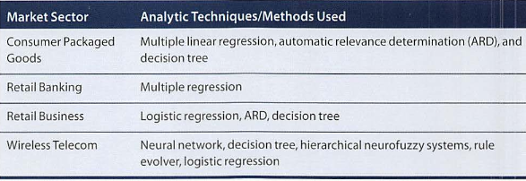
Phase 3: Model Planning Model Planning in Industry Verticals
Example of other analysts approaching a similar problem

Slide 23
Data Exploration and Variable Selection
Explore the data to understand the relationships among the variables to inform selection of the variables and methods
A common way to do this is to use data visualization tools
Often, stakeholders and subject matter experts may have ideas
For example, some hypothesis that led to the project
Aim for capturing the most essential predictors and variables
This often requires iterations and testing to identify key variables
If the team plans to run regression analysis, identify the candidate predictors and outcome variables of the model

Slide 24
Model Selection
The main goal is to choose an analytical technique, or several candidates, based on the end goal of the project
We observe events in the real world and attempt to construct models that emulate this behavior with a set of rules and conditions
A model is simply an abstraction from reality
Determine whether to use techniques best suited for structured data, unstructured data, or a hybrid approach
Teams often create initial models using statistical software packages such as R, SAS, or Matlab
Which may have limitations when applied to very large datasets
The team moves to the model building phase once it has a good idea about the type of model to try

Slide 25
Common Tools for the Model Planning Phase
R has a complete set of modeling capabilities
R contains about 5000 packages for data analysis and graphical presentation
SQL Analysis services can perform in-database analytics of common data mining functions, involved aggregations, and basic predictive models
SAS/ACCESS provides integration between SAS and the analytics sandbox via multiple data connections

